Slide 1

Antibody Mediated Prevention:
HVTN 703/HPTN 081 Update
Pamela G. Marimbe-Nyatsambo
MBChB (UZ)
University of Zimbabwe - University of California San Francisco Collaborative Research Program
Annual Research Day
05 May 2017
Notes:
Despite early optimism about immunological approaches to prevent and treat human immunodeficiency virus (HIV), after more than three decades there are no li-censed HIV preventative or therapeutic vaccines. This session outlines the path toward novel vaccine designs that employ active and passive immunization strategies to prevent HIV acquisition.
My talk will focus on passive immunisation efforts, which are novel to the field

Slide 2
AMP = Antibody Mediated Prevention
Can a passively infused monoclonal antibody(VRC01)
prevent HIV-1 infection in high risk adults?
Two harmonized protocols:
The AMP Studies:
HVTN 704/HPTN 085
( 2700 MSM and TG in the Americas, Europe)
HVTN 703/HPTN 081
( 1500 Women in sub-Saharan Africa)
Notes:
Defining a new path forward:
This is the idea of using an antibody made in the lab and giving it to people directly, i.e. using an intravenous (IV) infusion, to prevent HIV infections.
AMP will be conducted as 2 harmonised protocols, each drawn from populations at high risk of HIV acquisition. The first population will comprise 2700 men and TG in North and South America who have anal sex with men or TG partners; the second population will comprise 1500 sexually active women in sub-Saharan Africa. The trial sample size is designed to provide 90% power to detect a prevention efficacy (PE) of 60% (rejecting the null hypothesis of 0% PE) for each population, based on reasonable assumptions regarding background HIV-1 incidence, retention, and frequency of infusions.

Slide 3
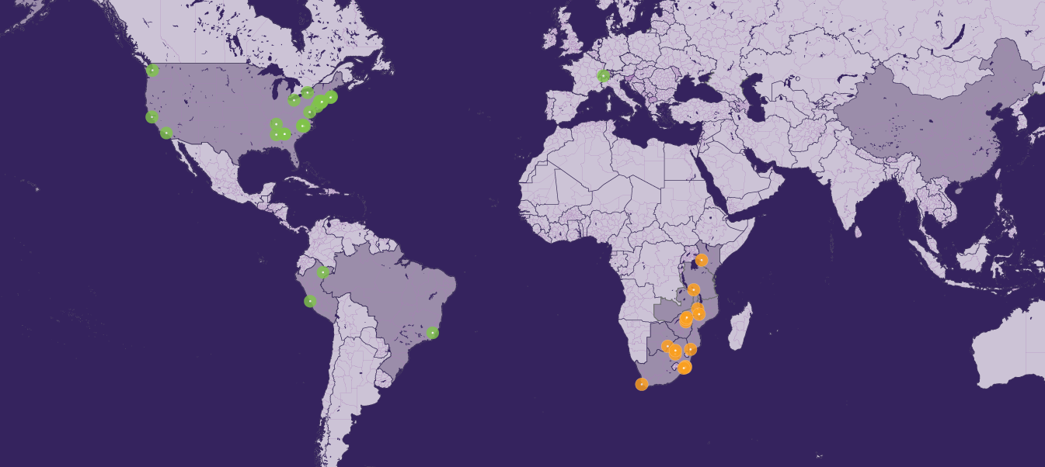
AMP Study Research Sites
(As of January, 2017)
HVTN 704/HPTN 084,
MSM + TG
HVTN 703/HPTN 081,
Women
Notes:
The HVTN and the HPTN work around the world. This picture shows the many research sites in the US, South America, Europe and Africa that will be involved in The AMP Study.

Slide 4
The Main AMP Study Questions
Is the VRC01 antibody safe to give to people?
Are people able to “tolerate” the antibody without becoming too uncomfortable?
Does the antibody lower people’s chances of getting infected with HIV?
If the antibody does lower people’s chances of getting infected with HIV, how much of it is needed to provide protection from HIV?

Slide 5


Study Schema for The AMP Studies
HVTN 704/HPTN 085
HVTN 703/HPTN 081
REGIMEN | MSM & TG in the Americas | Women in sub-Saharan Africa | TOTAL
VRC01 10 mg/kg | 900 | 500 | 1300 | 10 infusions total - given every 8 weeks Study duration: ~22 months
VRC01 30 mg/kg | 900 | 500 | 1300
Control | 900 | 500 | 1300
Total | 2700 | 1500 | 4200
Notes:
10 infusions given every 8 weeks from eek 0 through week 72
♦ Week 80 is the last study visit for the primary endpoint analysis of prevention efficacy.
† Week 92 is the last study visit for the co-primary endpoint analysis of safety and tolerability.
*

Slide 6
AMP Study Procedures
IV: receive an IV over a 30-60 minute period every 8 weeks (10 times total)
Blood draw: get a blood draw at the clinic every 4 weeks (includes an HIV test)
STI testing: get STI testing (urine and vaginal swabs) about every 6 months
Questionnaires: complete questionnaires about sexual behavior & general health every 4-8 weeks
STUDY DURATION: about 22 months

Slide 7
Our Successes to Date
Stakeholder meetings, 2 to date , has provided a platform for discussions related to the implementation of AMP in their communities.
Successful ongoing community engagement
Notes:
This meeting brought together:
Governmental and nongovernmental organizations, public health advocates, institutional review board members, research staff, community officials and traditional and/or spiritual healers who are committed to identifying HIV prevention strategies that address the diverse needs of research communities

Slide 8
Study product well tolerated
To date:
  No SAEs related to study product
  No anaphylaxis

Slide 9
Summary as of 02 May 2017
703/081
African Women
641* of 1,500
enrolled
96% retention over 2,690 visits
Total Enrollment: 641
Protocol Target: 1500
Enrollment Needed: 859
*
>120% of expected ENR
Notes:
Only 9 missed infusions across both trials

Slide 10
Zim Sites Status
3 sites
1st enrollment on 13 Dec 2016
Currently 133/225 participants enrolled
No SAEs

Slide 11
Adherence
Participants Enrolled | 641
Infusion 1 | 641/641 (100%)
Infusion 2 | 399/402 (99%)
Infusion 3 | 252/255 ( 99%)
Infusion 4 | 179/182 (98%)
Infusion 5 | 81/84 ( 96%)
Infusion 6 | 29/30 (97%)
Infusion 7 | 3/3 (100%)
All Visits | 1584/1597( 99%)
Notes:
Adherence = # Participants who received the infusion / #Participants completed the infusion visit.
The infusion is considered received once a Post-Enrollment IV Infusion Administration form indicating that the infusion was administered is received and entered into the study database.

Slide 12



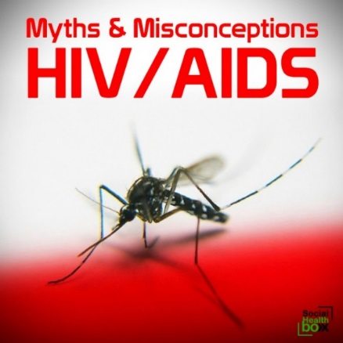
Rumours, Myths and Misconceptions about HIV, Blood, and Contraception
Too much
Too little
Notes:
majority of women not on contraception at screening
- we partnered with an organization which provides FP services
-did further training of staff on all contraceptive methods
lack of knowledge is a major deterrent on contraceptive uptake
-extensive FP counseling helps

Slide 13
P1112
Overview and update

Slide 14
Protocol P1112: Study Overview
Open label, dose-escalating, phase I study of safety and pharmacokinetics of single dose VRC01, At birth (within 72 hours) in HIV exposed infants at high risk of peripartum HIV acquisition

Slide 15
Protocol P1112
Primary Objectives
– To assess safety of single SC dose of VRC01
– To determine PK profile of VRC01 when given as a single SC dose
Secondary Objectives
– To examine anti-VRC01 antibody production following immunization
– To assess the amount of VRC01 antibody in oral secretions
Notes:
The present study will allow us to gather safety and PK data that will inform a larger (efficacy?) study in breast fed infants

Slide 16
Current update
Zimbabwe started enrolments on 19 Jan 2017 into the (VRC01 breastfeeding cohort)
South Africa and Zimbabwe only sites internationally identified to implement dose group 3
Enrolled 3 of the 13 in this cohort, closed to accrual
All 3 are on active follow-up receiving monthly VRC01 , no adverse events reported to date

Slide 17






Acknowledgements
AMP STUDY PARTICIPANTS
AMP PROTOCOL TEAM
UZ-UCSF CAB
UZ-UCSF COLLABORATIVE RESEARCH PROGRAMME
HPTN NETWORK
HVTN NETWORK
IMPAACT NETWORK
FHI 360
NIH, NIAID

Slide 18


