Slide 1


Quantitative Adherence Measurement In Infants Receiving ARV Syrups: P1115
Zimbabwe, Harare Family Care Experience
T . P. MHEMBERE: BSc Pharm Hons (Zim), MPH (UK)

Slide 2
Potential Conflicts and Financial Disclosure
I have no actual or potential conflicts to declare in relation to this presentation.
Research Support: US National Institutes of Health, UZ College Health Sciences – Clinical Trial Research Centre

Slide 3
Presentation Outline
Background
Methods
Results
Discussion
Conclusion

Slide 4
Adherence Defined
“the extent to which a person’s behaviour – taking medication, following a diet, and/or executing lifestyle changes, corresponds with agreed recommendations from a health care provider.” WHO 2003
Optimum adherence key to treatment success!

Slide 5
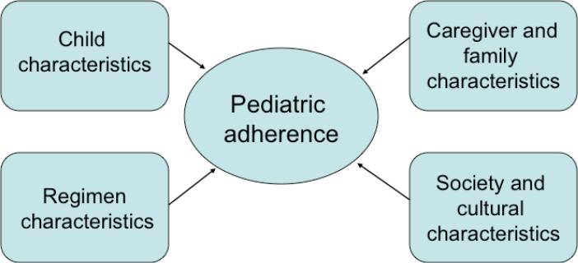
Factors Affecting Paediatric Adherence

Slide 6

Methods of Measuring Adherence
Self-reporting
Pill counts
Pharmacy records
Provider estimate
Pill identification test
Electronic devices—MEMS
Biological markers—Viral load
Measuring medicine levels

Slide 7
Measuring Paediatric Adherence
NO GOLD STANDARD
BUT at least one method of measuring adherence to ART should be used in addition to monitoring viral load
  BFarley JJ, Montepiedra G, Storm D, et al. Assessment of adherence to antiretroviral therapy in perinatally HIV-infected children and youth using self-report measures and pill count. J Dev Behav Pediatr. 2008;29(5):377-384.
  Khan M, Song X, Williams K, Bright K, Sill A, Rakhmanina N. Evaluating adherence to medication in children and adolescents with HIV. Arch Dis Child. 2009;94(12):970-973.
  Burack G, Gaur S, Marone R, Petrova A. Adherence to antiretroviral therapy in pediatric patients with human immunodeficiency virus (HIV-1). J Pediatr Nurs. 2010;25(6):500-504.

Slide 8
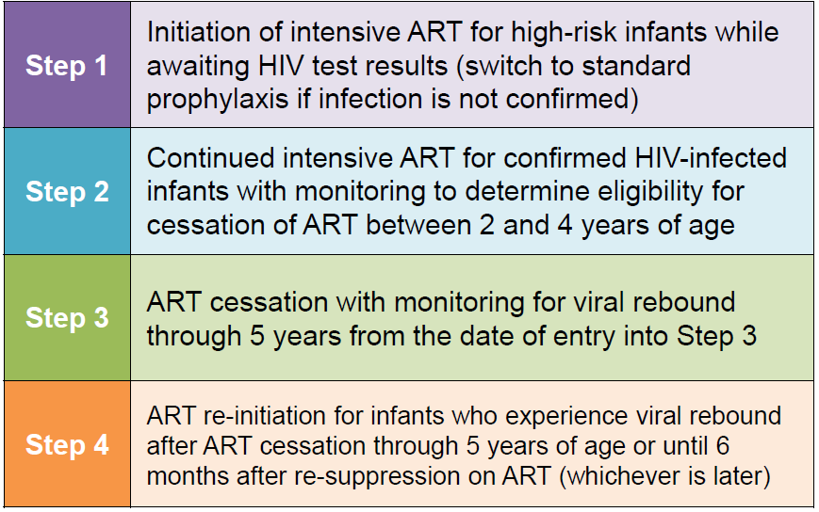
P1115 Background
To assess HIV remission among HIV-infected neonates who initiate ART within 48 hours of birth

Slide 9

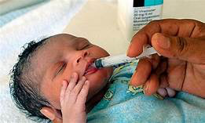


Confirm HIV infection
Continue ARVs if infected
HIV infected Mum
14 (10%) infants
infected
Start ARVs within 48hrs
136 enrolled
Continue ARVs to 84 weeks and evaluate for stopping.

Slide 10
Adherence Measure
A Structured Adherence questionnaire was administered at every visit in order to document self-reported adherence.
Viral loads were performed routinely and were used for clinical management as well as a surrogate marker for adherence.
Harare Family Care CRS further assessed adherence quantitatively using returned syrups
ALL PARTICIPANTS RECEIVED COMPREHENSIVE ADHERENCE COUNSELLING

Slide 11

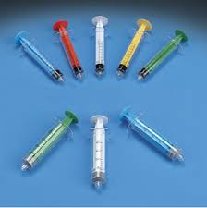
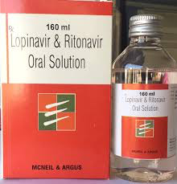
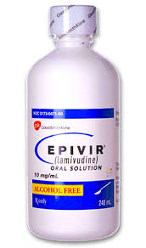

Drug Dispensing
Colour Coded syringes marked with exact dose
Caregivers were asked to return all medication containers at review visits
Drugs dispensed in the original medication containers fitted with Press In Bottle Adapters (PIBAs) to minimise spillage during dose withdrawal.

Slide 12



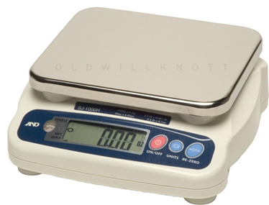


Adherence Measure
Arithmetic mean of the individual drugs considered as visit adherence.
91 pharmacy chart notes were reviewed up to week 24

Slide 13
RESULTS
REASON (n=91) | ADHERENCE ≤94% | ADHERENCE >100%
Spillage during dosing | - | 13 (14.3%)
Other spillage | - | 16 (17.6%)
Withdrawal challenges | 3 (3.3%) | 4 (4.4%)
Travel | 4 (4.4%) | -
Secondary Caregiver | 3 (3.3%) | -
Not specified | 3 (3.3%) | 4 (4.4%)
Redosing | - | 14 (15.4%)
No electricity | 1 (1.1%) | -
Non return of bottles | - | 1 (1.1%)
25 (27.4%) had 95-100% adherence
Calculated adherence was >100% in (52/91) 57% of the times.
Calculated adherence was in ≤ 94% in 14/91 records.

Slide 14
Figure 1- Calculated Adherence up to 24weeks

Slide 15
Discussion
Reasons for non-optimal adherence were offered by the caregivers after being presented with the calculated adherence results at the pharmacy despite some indicating no challenges in initial discussions with clinicians.
Adherence improved over the 24weeks.
Continued Adherence Counselling included but not limited to
i) Drug administration training,
ii) Good storage practices
iii) Practical reminders

Slide 16

Conclusion
The availability of quantitative adherence measurement in combination with viral loads provided checkpoints for composite Adherence monitoring in P1115 at HFC
Quantitative adherence measure was valuable in shaping adherence counselling provided to caregivers.
  PATIENT-CENTRED CARE

Slide 17





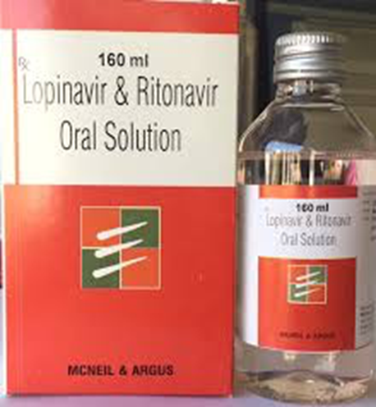
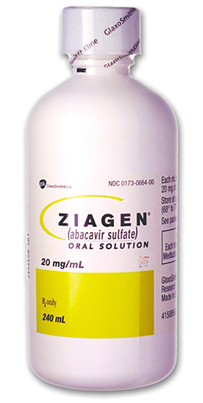
Zimbabwean Context
What we need to consider…
Birth Testing

Slide 18

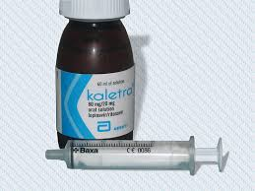
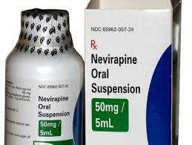



TATENDA

